Slide 2
laura@lauramfoley.com
lauramfoley.com
facebook.com/LMFDesign
linkedin.com/in/lauramfoleydesign

Slide 3


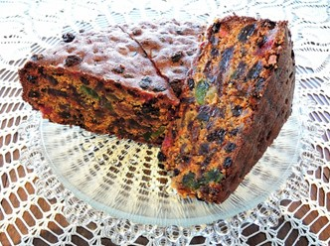
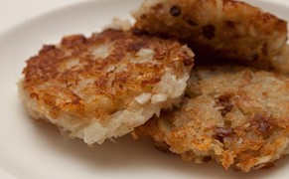
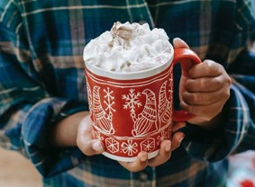
Movies
Gifts
Food
Traditions
Elf on a Shelf
What is your
favorite holiday movie and why?
???
You’ve just received a hideous gift. Thank the giver as best you can.
???
FRUITCAKE!
???
How do you typically spend New Year’s Eve? How will you be celebrating it this year?
???
Is the Elf on a Shelf a mischievous scamp or
a nasty snitch?
???
Christmas movie or not? Pick one:
Die Hard
Gremlins
Home Alone
???
What would be a
terrible gift to give to
a client or your boss? (Keep it clean, people!)
???
LATKES!
???
Do you decorate
your home for
the holidays?
Why or why not?
???
Would Elf on a Shelf
have influenced your behavior as a kid?
???
Talk about the
best holiday movie never made.
???
Talk about a favorite holiday gift you’ve given or received.
???
COCOA!
???
Talk about a favorite holiday tradition in
your family.
???
The Mensch on a Bench doll inspires acts of kindness during the holiday season. Which doll do you prefer?
???
Latke photo © J Doll via Wikimedia Commons CC by 3.0

