Slide 1
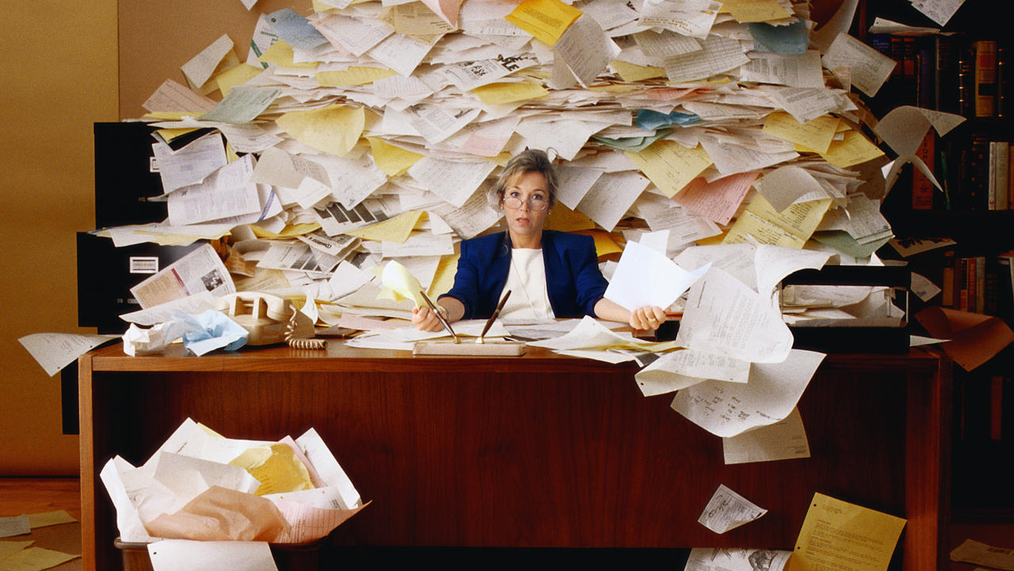
Your organized life
Presented by Jean Clean, a reformed slob
Hello, Akron!!!
Take back your desk!
Like me on Facebook and become part of the OrganizedNation!
http://Tinycc/JeanClean
Be the first person to raise your hand when I name a novel use for paper clips and
win a free 1-hour consultation!
Want more decluttering tips? Sign up for my newsletter!
JeanClean.com/newsletter
TWEETING?
Follow me! @JeanClean
#DeclutterAkron
10 storage and filing solutions to simplify and declutter your home or office

